Slide 1
Lecture
Access – VBA

Slide 2
What’s BASIC?
Beginners All-Purpose Symbolic Instruction Code – BASIC
Event driven
Designed in 1964 Dartmouth
  For non-computer science students
  Students too lazy to learn Fortran and other programming languages
Basis for Gates & Allen success
  Altair M.I.T.S. (Micro Instrumentation & Telemetry System)
  Start of Microsoft

Slide 3
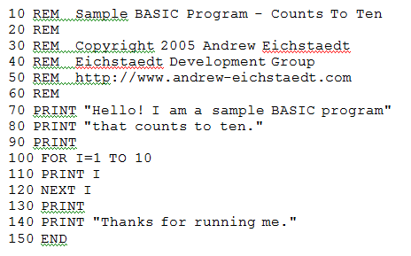
Simple Basic script
Standard sample count-to-ten program in old-school BASIC:

Slide 4
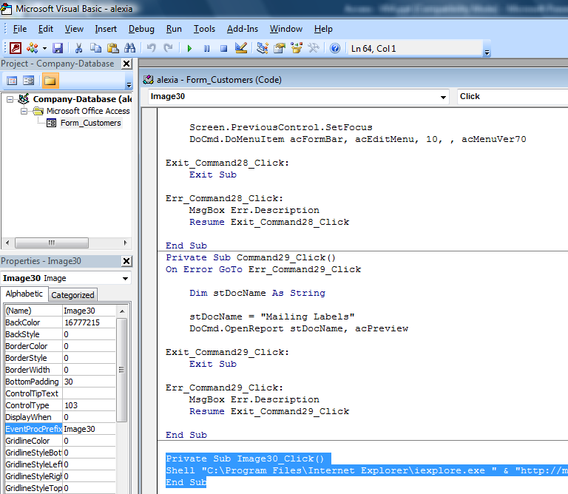
Visual Basic - 1991
Pioneered by Alan Cooper
Enhanced by Microsoft’s development group
GUI
Stand alone program
Part of Visual Studio

Slide 5
Visual Basic - 1991
Used to develop complex applications
Involves visually arranging components or controls on a form
Then specifying attributes and actions of those components
Writing additional lines of code for more functionality.

Slide 6
What’s VBA?
Visual Basic for Applications
  Embedded w/Program
Custom code to enhance:
  Forms
  Reports
Can be used for:
  Formatting
  Security
  Saving Time

Slide 7
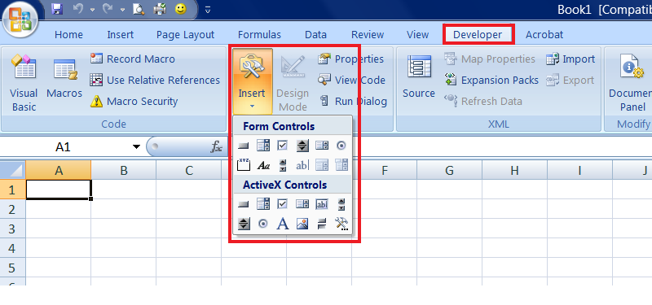
VBA in Excel
Same controls that are in Access are available in other applications.

Slide 8
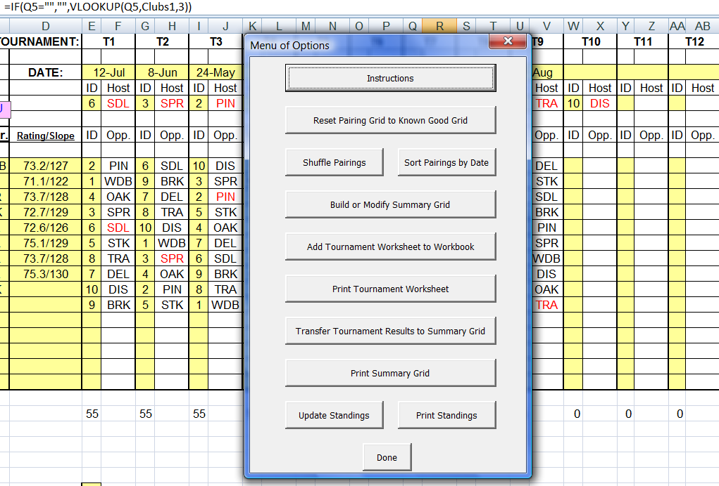
VBA in Excel
Develops menus, commands and integrated content

Slide 9
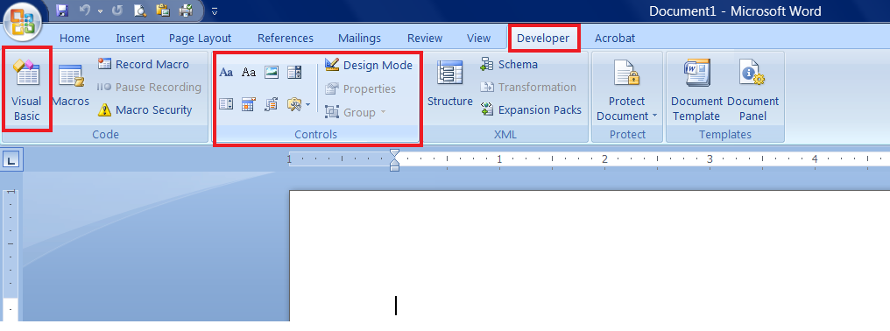
VBA in Word
To enhance and add more functionality to Word

Slide 10
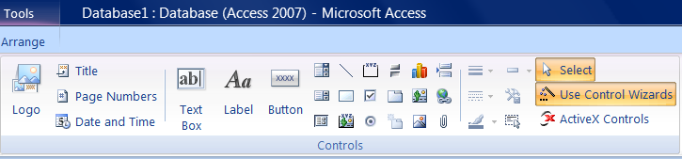
VBA for Access
Same toolbar you have been using to add formatting to your reports & forms
Control Wizards enable easy use of VBA

Slide 11
Two Ways to Make a Button
Use the Wizard for common tasks
  Find/Filter/Sort Data
  Open a Report/Form/Query
  Exit the Program
  Etc
Use your own code for…
  Just about anything you can imagine

Slide 12
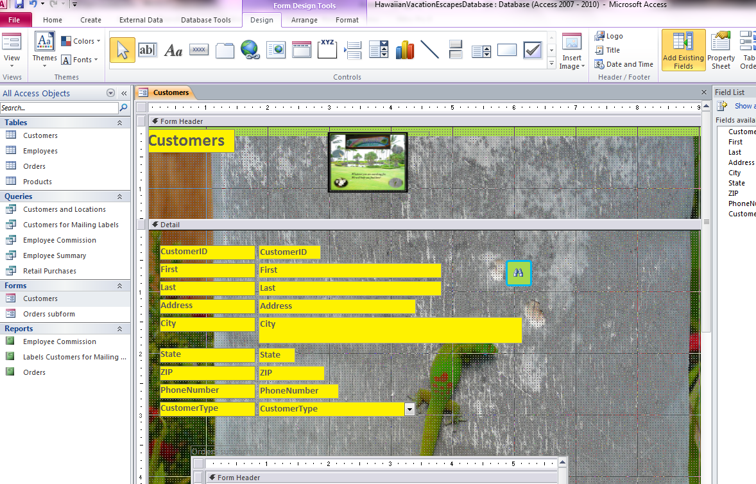
Adding a Button
Activate your Control Toolbar to add a button.

Slide 13
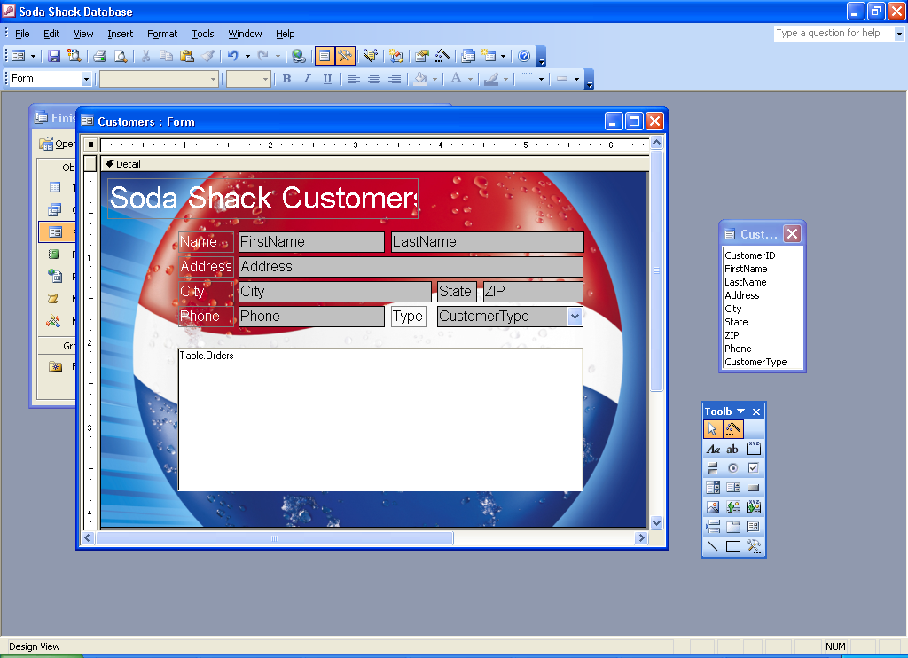

Button Wizard Step 1
Use the Command Button icon to add a button on your form.
Make sure the Control Wizard
is turned on.

Slide 14
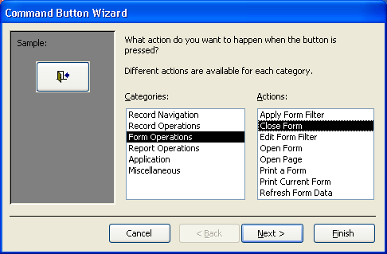
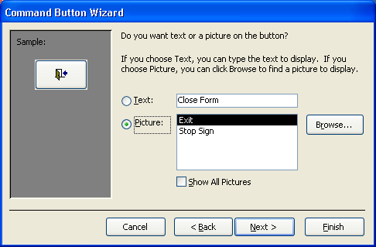
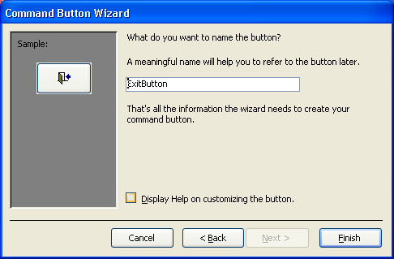
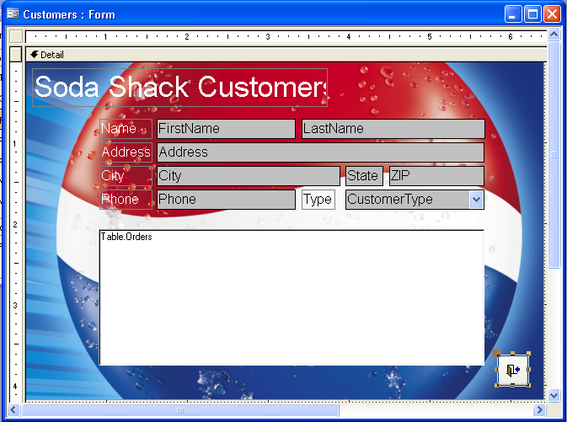
Button Wizard Step 2
Pick an icon.
Name the button.
Tell the Wizard what you want the button to do. Choose from the categories.
Position/resize the button how you like.

Slide 15
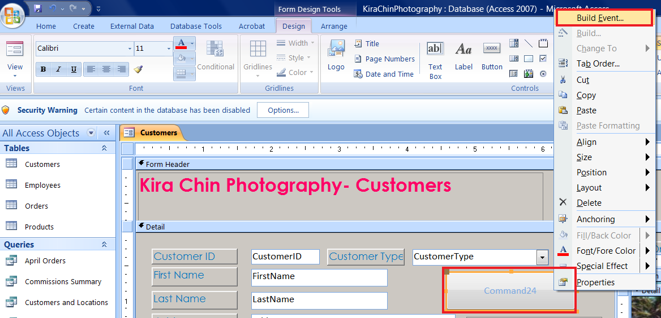
Custom Buttons
Adding your own code 1:
Turn off Wizard or Cancel
Drag in a button and click Right Mouse to Build Event

Slide 16
Custom Buttons
Adding your own code 2:
Add or edit your
Custom code in the
VBA Editor.

Slide 17
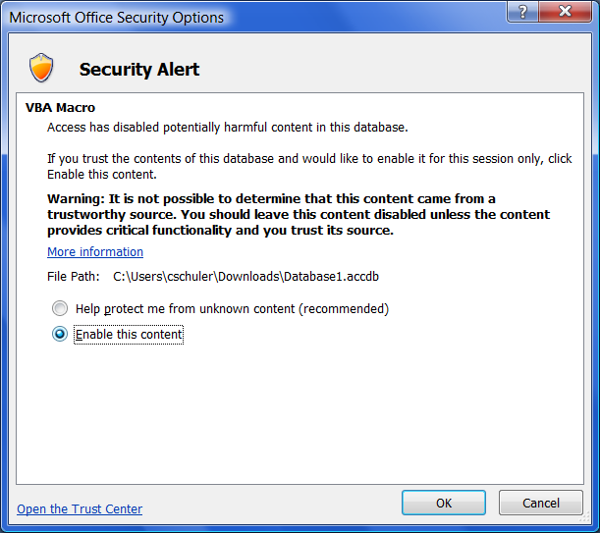
Enabling VBA Content
Due to potential security risks, all VBA content must be enabled before it can run:
Click Options
Click Enable Content
Your VBA buttons
won’t run unless you
do this.

